Slide 1
Application of Kolmogorov-Arnold and deep Neural Networks for Modeling Gibbs Free Energy of Mixing Modified by Global Renormalization Group Theory
Ji-En Li¹, Yen-Jen Shih², David Shan Hill Wong¹ Shang-Tai Lin²
¹Department of Chemical Engineering, National Tsing Hua University, Hsinchu, Taiwan
²Department of Chemical Engineering, National Taiwan University, Taipei, Taiwan

Slide 2
Introduction

Slide 3
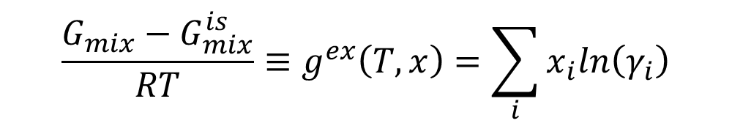
Solution Models
$${\frac{G_{mix}−G_{mix}^{is}}{RT}≡g}^{ex}\left(T,x\right)=\sum_{i}{x_{i}ln\left(γ_{i}\right)}$$
Deviations from an ideal solution mixture are often quantitied by excess gibbs free energy models and activity coefficient models based on local composition theory

Slide 4
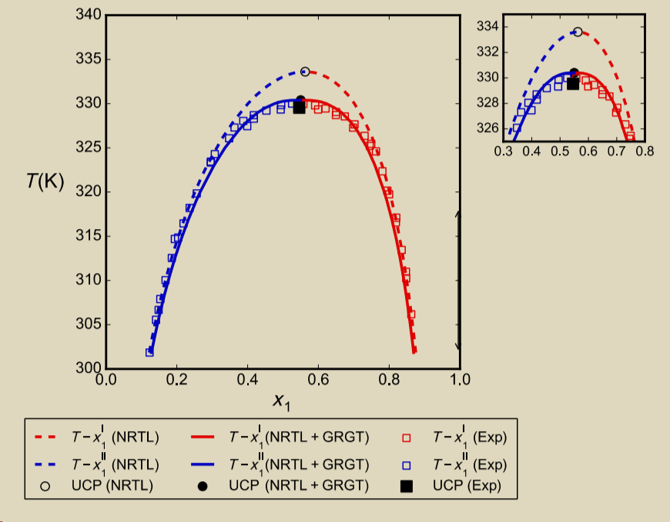
Research Motivation
These solution models are based on Mean-Field Theory, which fail to describe critical behavior.
Using models like global renormalization group theory (GRGT), predictions near critical region can be improved.
However, analytical expressions of the transformed models cannot be obtained, hence they cannot be used in process simulations.
In machine learning neural networks are claimed to be “universal approximators”.
In this work, we attempt to use of neural networks to represent the GRGT model
Phenol+Acteone
Shih, Y. J., & Lin, S. T. (2025). New strategy for predicting liquid–liquid equilibrium near critical point using global renormalization group theory. AIChE Journal, 71(5), e18738.

Slide 5
Methodology

Slide 6

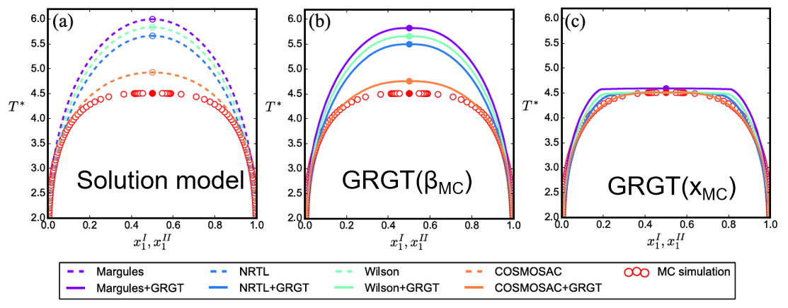


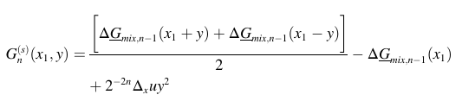



Global Renormalization Group Theory
u=12J, is the site interaction energy

Slide 7
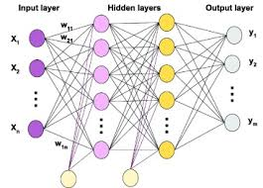
Multi-Layer Perceptron Network (MLP)
MLP is perhaps the most commonly used neural network.
It consists of an input layer, one or more hidden layers.
In these layers are nodes of activation functions
Common activations include tanh, sigmoid, ReLU
Nodes between layers are connected by weights.

Slide 8
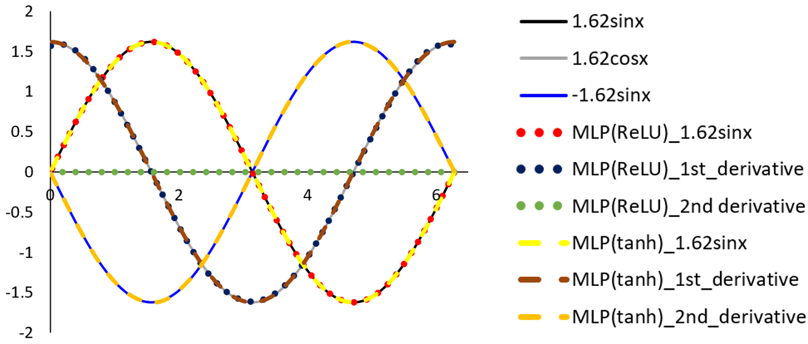
Derives of MLP
Some activations such as linear, ReLU are piecewise linear funtions.
Hence their second derivatives are zero.
Therefore models constructed using these activations cannot be used in phase equilibrium calculations which involve second serivatives of excess Gibbs free energy.
In this work the activation of tanh is used.

Slide 9
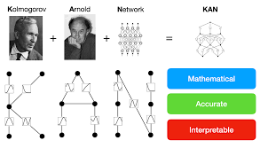
Kolmogorov-Arnold Network KAN
Recently KAN was propsed and proved also to be an universal approximator.
As opposed to MLP, activation functions (usually spline) are placed on the connection edges.
KAN claimed to be more mathematical and interprettable
All inputs have to be in the range [0,1]
Liu, Z., Wang, Y., Vaidya, S., Ruehle, F., Halverson, J., Soljačić, M., ... & Tegmark, M. (2024). Kan: Kolmogorov-arnold networks. arXiv preprint arXiv:2404.19756.

Slide 10
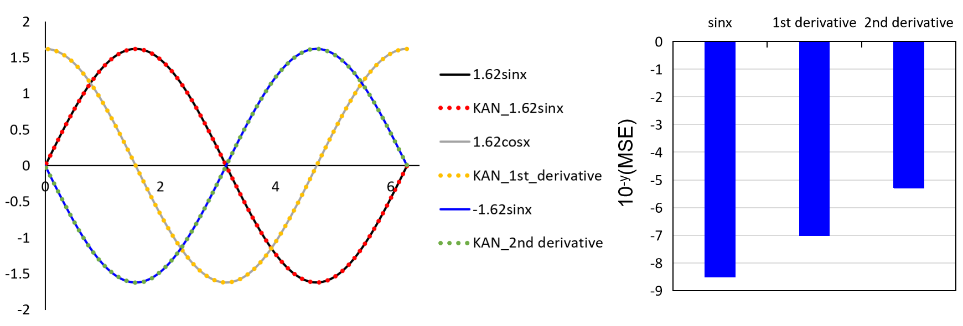
Derivatives of KAN
Even though the derivates can be reasonably represente, their accuracies are orders of magnitude higher than the functions if derivatives are not considered.

Slide 11
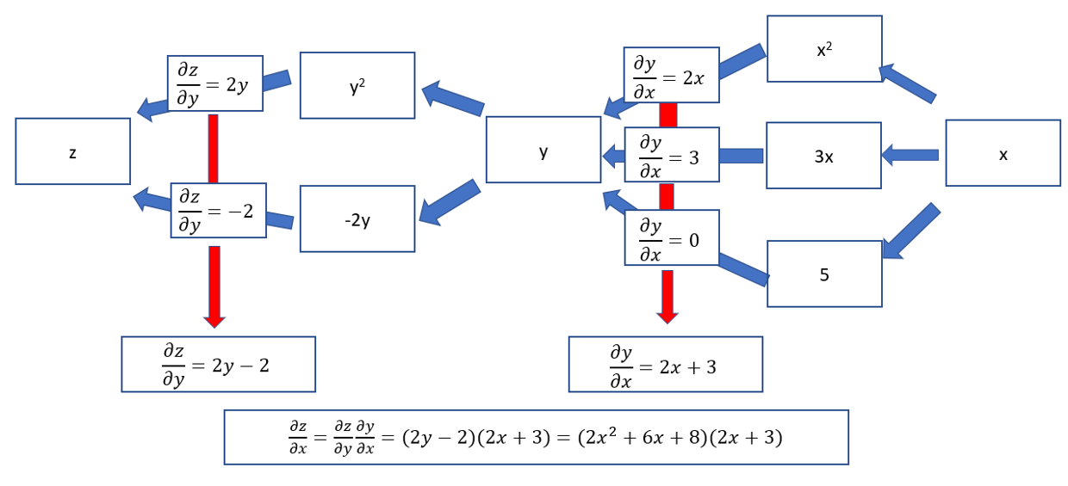
Autograd
In machine learning, derivates of neural networks are computed using the AUTOGRAD tool.

Slide 12
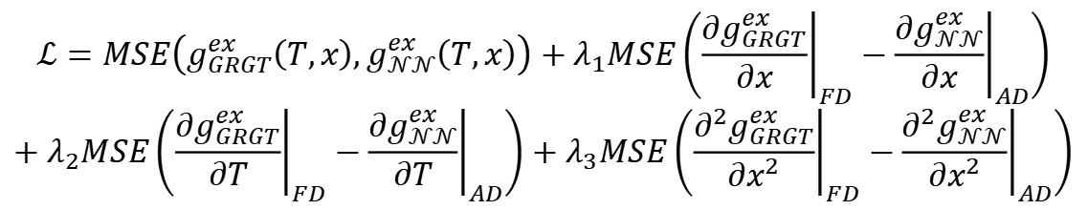
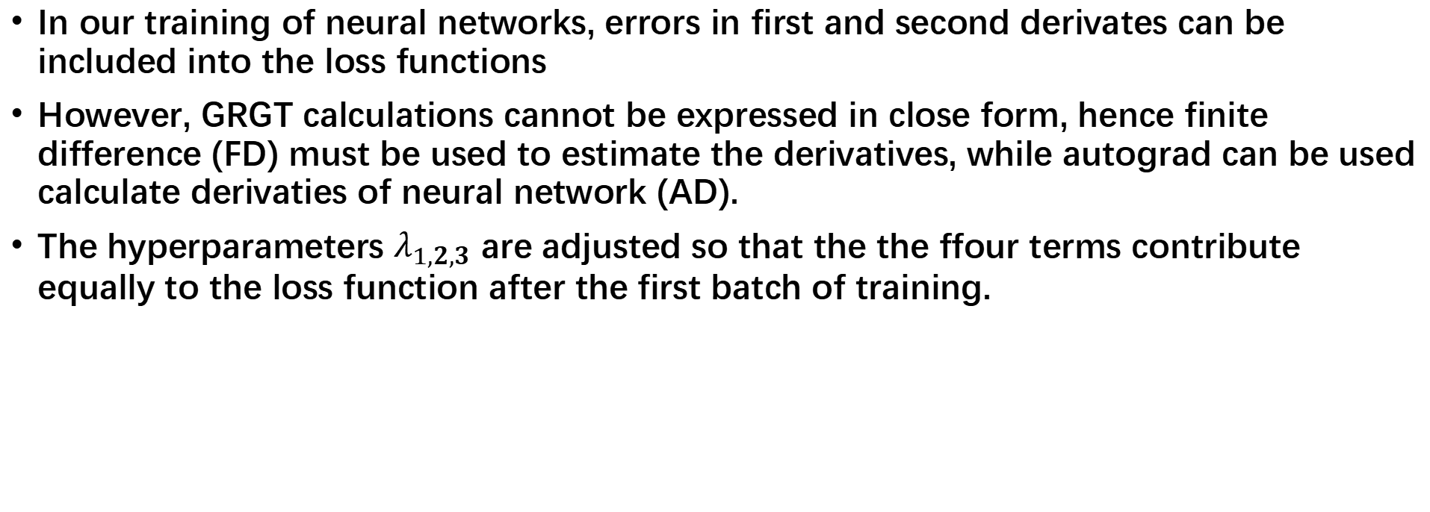
Training Derivates
In our training of neural networks, errors in first and second derivates can be included into the loss functions
However, GRGT calculations cannot be expressed in close form, hence finite difference (FD) must be used to estimate the derivatives, while autograd can be used calculate derivaties of neural network (AD).
The hyperparameters $λ_{1,2,3}$ are adjusted so that the the ffour terms contribute equally to the loss function after the first batch of training.
$$ℒ=MSE\left(g_{GRGT}^{ex}\left(T,x\right),g_{𝒩𝒩}^{ex}\left(T,x\right)\right)+λ_{1}MSE\left({\left.\frac{∂g_{GRGT}^{ex}}{∂x}\right|}_{FD}−{\left.\frac{∂g_{𝒩𝒩}^{ex}}{∂x}\right|}_{AD}\right)$$
$$+λ_{2}MSE\left({\left.\frac{∂g_{GRGT}^{ex}}{∂T}\right|}_{FD}−{\left.\frac{∂g_{𝒩𝒩}^{ex}}{∂T}\right|}_{AD}\right)+λ_{3}MSE\left({\left.\frac{∂^{2}g_{GRGT}^{ex}}{∂x^{2}}\right|}_{FD}−{\left.\frac{∂^{2}g_{𝒩𝒩}^{ex}}{∂x^{2}}\right|}_{AD}\right)$$

Slide 13
Proof of Concept Using two-Suffix Margules Equation

Slide 14

Two-Suffix Margues Equation
The
$$g^{ex}=A\left(T\right)x_{1}\left(1−x_{1}\right)$$
$${T=T}_{c},A=2$$
$$g^{ex}\left(T_{R},x_{1}\right)≡\frac{2}{T_{R}}x_{1}\left(1−x_{1}\right)$$
$$T_{R}=\frac{T}{T_{C}},T_{R}<1,A>2,T_{R}=1,A=2,T_{R}>1,A<2.$$

Slide 15
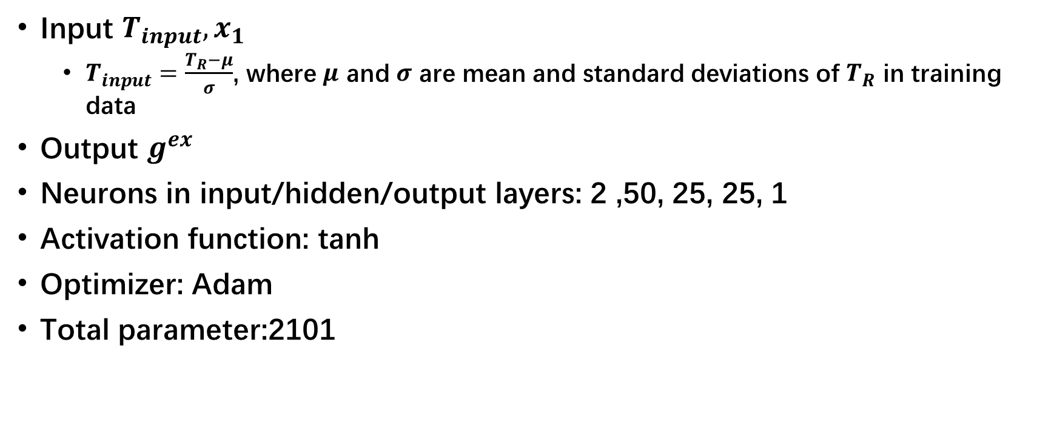
Model Structure MLP
Input $T_{input},x_{1}$
$T_{input}=\frac{T_{R}−μ}{σ}$, where $μ$ and $σ$ are mean and standard deviations of $T_{R}$ in training data
Output $g^{ex}$
Neurons in input/hidden/output layers: 2 ,50, 25, 25, 1
Activation function: tanh
Optimizer: Adam
Total parameter:2101

Slide 16
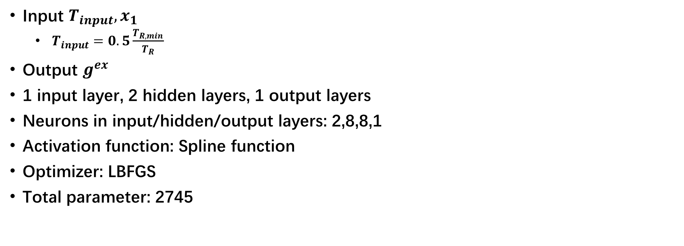
Model Structure KAN
Input $T_{input},x_{1}$
$T_{input}=0.5\frac{T_{R,min}}{T_{R}}$
Output $g^{ex}$
1 input layer, 2 hidden layers, 1 output layers
Neurons in input/hidden/output layers: 2,8,8,1
Activation function: Spline function
Optimizer: LBFGS
Total parameter: 2745

Slide 17
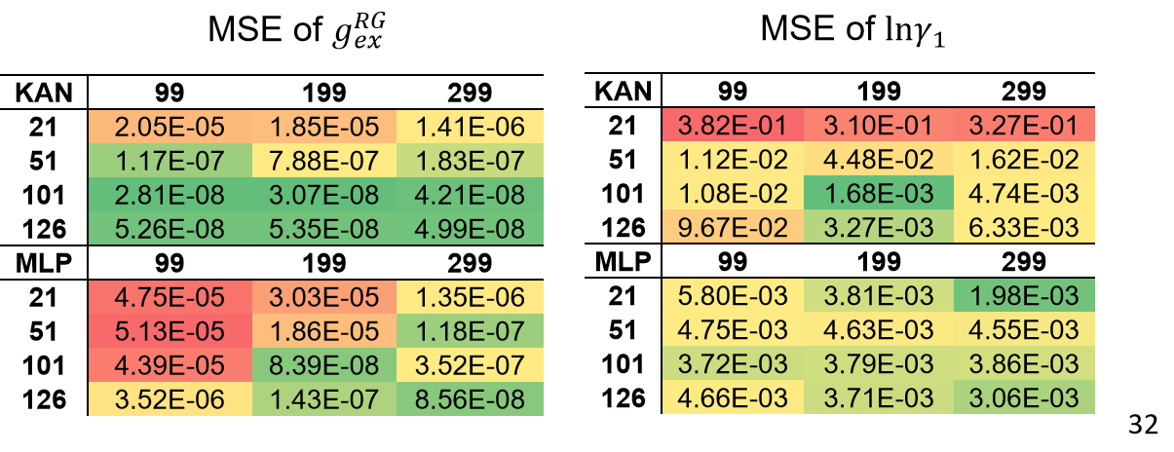



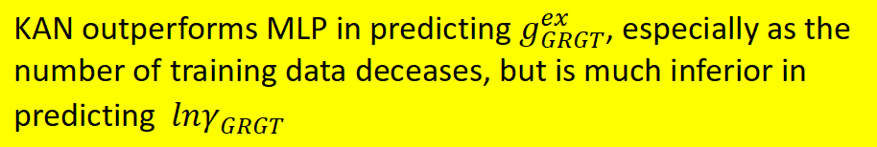
Results without considering derivatives
Rows are number of temperature training points
Colums are number of mole fraction training points
The results are trained using only the loss term $MSE\left(g_{GRGT}^{ex}\left(T,x\right),g_{𝒩𝒩}^{ex}\left(T,x\right)\right)$
$$MSE\left(g_{GRGT}^{ex}\left(T_{R},x\right),g_{𝒩𝒩}^{ex}\left(T_{R},x\right)\right)$$
$$MSE\left({lnγ}_{GRGT}^{}\left(T_{R},x\right),{lnγ}_{𝒩𝒩}^{}\left(T_{R},x\right)\right)$$
KAN outperforms MLP in predicting $g_{GRGT}^{ex}$, especially as the number of training data deceases, but is much inferior in predicting ${lnγ}_{GRGT}^{}$

Slide 18
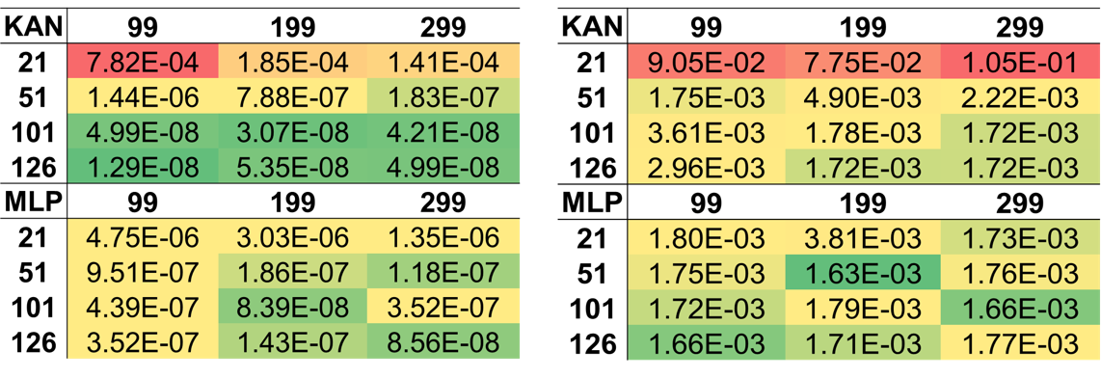
Results considering derivatives
Rows are number of temperature training points
Colums are number of mole fraction training points
The results are trained using only the loss term $MSE\left(g_{GRGT}^{ex}\left(T,x\right),g_{𝒩𝒩}^{ex}\left(T,x\right)\right)$
$$MSE\left(g_{GRGT}^{ex}\left(T_{R},x\right),g_{𝒩𝒩}^{ex}\left(T_{R},x\right)\right)$$
$$MSE\left({lnγ}_{GRGT}^{}\left(T_{R},x\right),{lnγ}_{𝒩𝒩}^{}\left(T_{R},x\right)\right)$$
Accuracy of KAN in predicting ${lnγ}_{GRGT}^{}$ improved.

Slide 19
Application to NRTL Model for Phenol+n-Octane

Slide 20
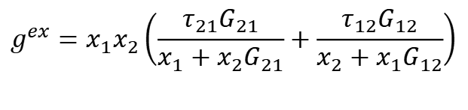

NRTL Model
$$g^{ex}=x_{1}x_{2}\left(\frac{τ_{21}G_{21}}{x_{1}+x_{2}G_{21}}+\frac{τ_{12}G_{12}}{x_{2}+x_{1}G_{12}}\right)$$
$$τ_{ij}=a_{ij}+\frac{b_{ij}}{T},G_{ij}=exp\left(ατ_{ij}\right)$$

Slide 21

Data Generation
Generated data: $N_{T}$ = 101, $∈[309.1K, 335K]$; $N_{x}$ = 501, $∈[0, 1]$
Training:Validation 9:1

Slide 22
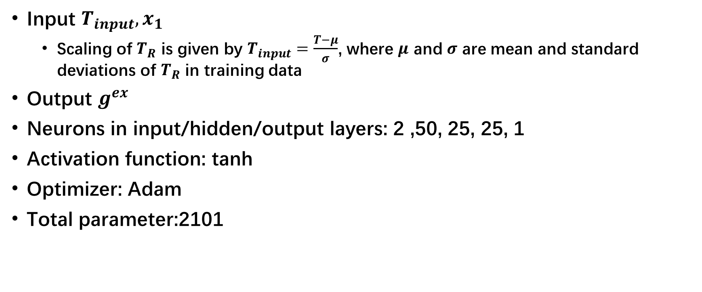
Model Structure MLP
Input $T_{input},x_{1}$
Scaling of $T_{R}$ is given by $T_{input}=\frac{T−μ}{σ}$, where $μ$ and $σ$ are mean and standard deviations of $T_{R}$ in training data
Output $g^{ex}$
Neurons in input/hidden/output layers: 2 ,50, 25, 25, 1
Activation function: tanh
Optimizer: Adam
Total parameter:2101

Slide 23
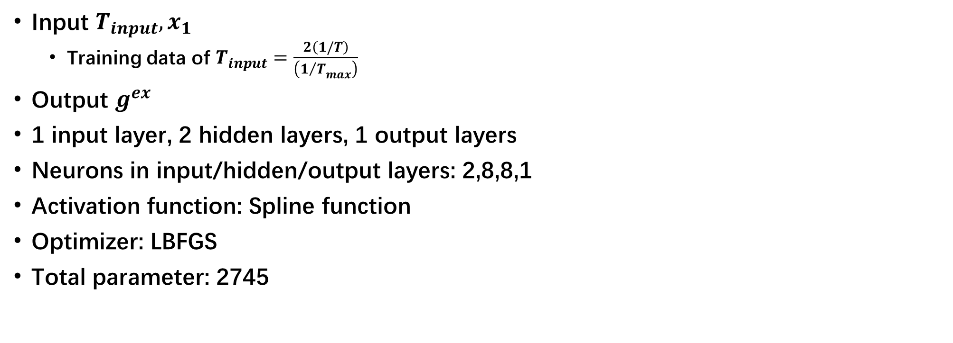
Model Structure KAN
Input $T_{input},x_{1}$
Training data of $T_{input}=\frac{2\left(1/T\right)}{\left({1/T}_{max}\right)}$
Output $g^{ex}$
1 input layer, 2 hidden layers, 1 output layers
Neurons in input/hidden/output layers: 2,8,8,1
Activation function: Spline function
Optimizer: LBFGS
Total parameter: 2745

Slide 24
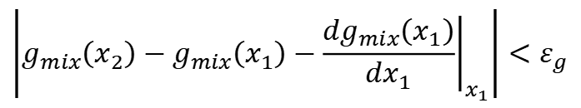


Phase Diagram Calculation
Tangent plane analysis is used.
Find a pair of $\left(x_{1},x_{2}\right)$ that satisfy the following condition
$$\left|g_{mix}\left(x_{2}\right)−g_{mix}\left(x_{1}\right)−{\left.\frac{dg_{mix}\left(x_{1}\right)}{dx_{1}}\right|}_{x_{1}}\right|<ε_{g}$$
$$\left|{\left.\frac{dg_{mix}\left(x_{1}\right)}{dx_{1}}\right|}_{x_{1}}−{\left.\frac{dg_{mix}\left(x_{2}\right)}{dx_{1}}\right|}_{x_{2}}\right|<ε_{d}$$

Slide 25
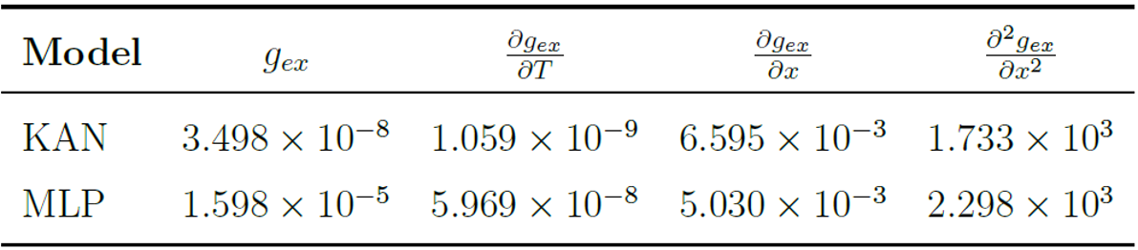


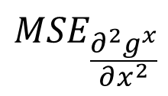

Model Accuracy
$${MSE}_{\frac{∂g^{x}}{∂T}}$$
$${MSE}_{\frac{∂g^{x}}{∂x}}$$
$${MSE}_{\frac{∂^{2}g^{x}}{∂x^{2}}}$$
$${MSE}_{g^{ex}}$$
KAN is better than MLP in accuracy in excess gibbs free energy and its temperature derivatives. The first and second derivatives of KAN and MLP are comparable. As infinite dilution activity coefficients at x=0 and x=1 are very high leading to large values of their derivatives and large MSE of the second derivatives. But percentage errors are acceptable

Slide 26
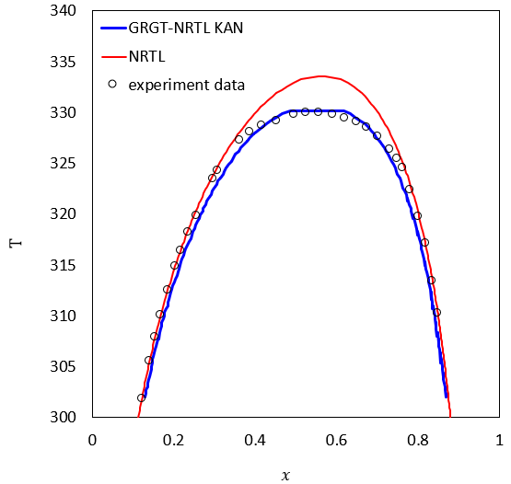
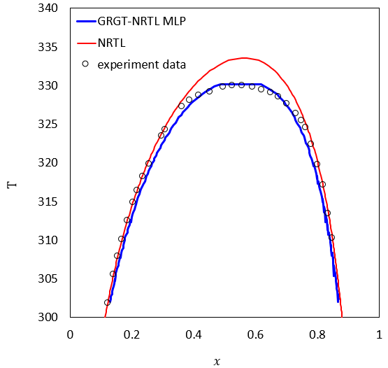
Phase Diagrams
T_{c,NRTL} =333.6K, T_{c,GRGT-NN} =330.2K

Slide 27
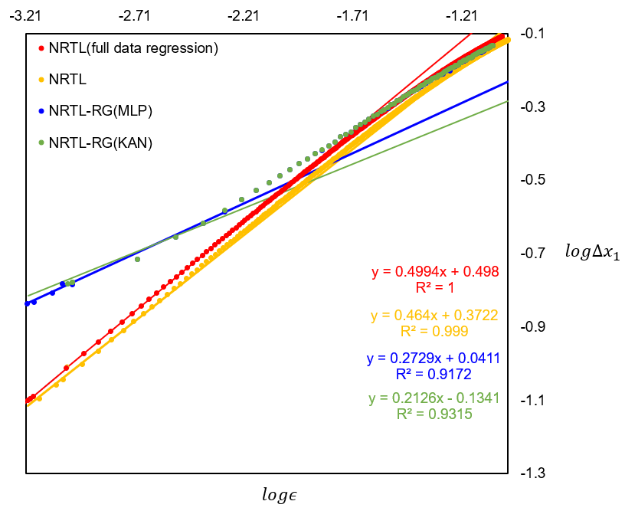

Critical Exponents
In$ε$<0.001, the slope are critical exponents of the corresponding models
$logε=\frac{T_{c}−T}{T_{c}}$

Slide 28
Conclusions
Both KAN and MLP networks are capable of approximating​ the excess Gibbs free energy data obtained by GRGT, predict phase behavior, and capturing critical behavior.
Hence these transformed models can be used for more ccurate phase equilibrium predictions near the critical point during process simulation
In construction of these models, t is essential to incorporate derivative-based loss terms during training.
KAN seems to be slightly better at energy fitting but MLP is also accurate enough for our process.

